Slide 1
Neural Networks and Deep Learning
Presenter
Md. Ferdous
Lecturer
Dept. of Computer Science and Engineering (CSE)
Bangabandhu Sheikh Mujibur Rahman Science and Technology University

Slide 2
Slide Credits and heartful thanks to
Dr. Md. Aminul Haque Akhand
Professor and Ex-head
Dept. of Computer Science and Engineering (CSE) Khulna University of Engineering & Technology (KUET) www.kuet.ac.bd/cse/akhand

Slide 3
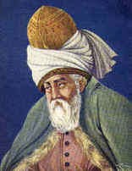
“Yesterday I was clever,
6
so I wanted to change the world.
Today I am wise,
so I am changing myself.”
— Rumi

Slide 4
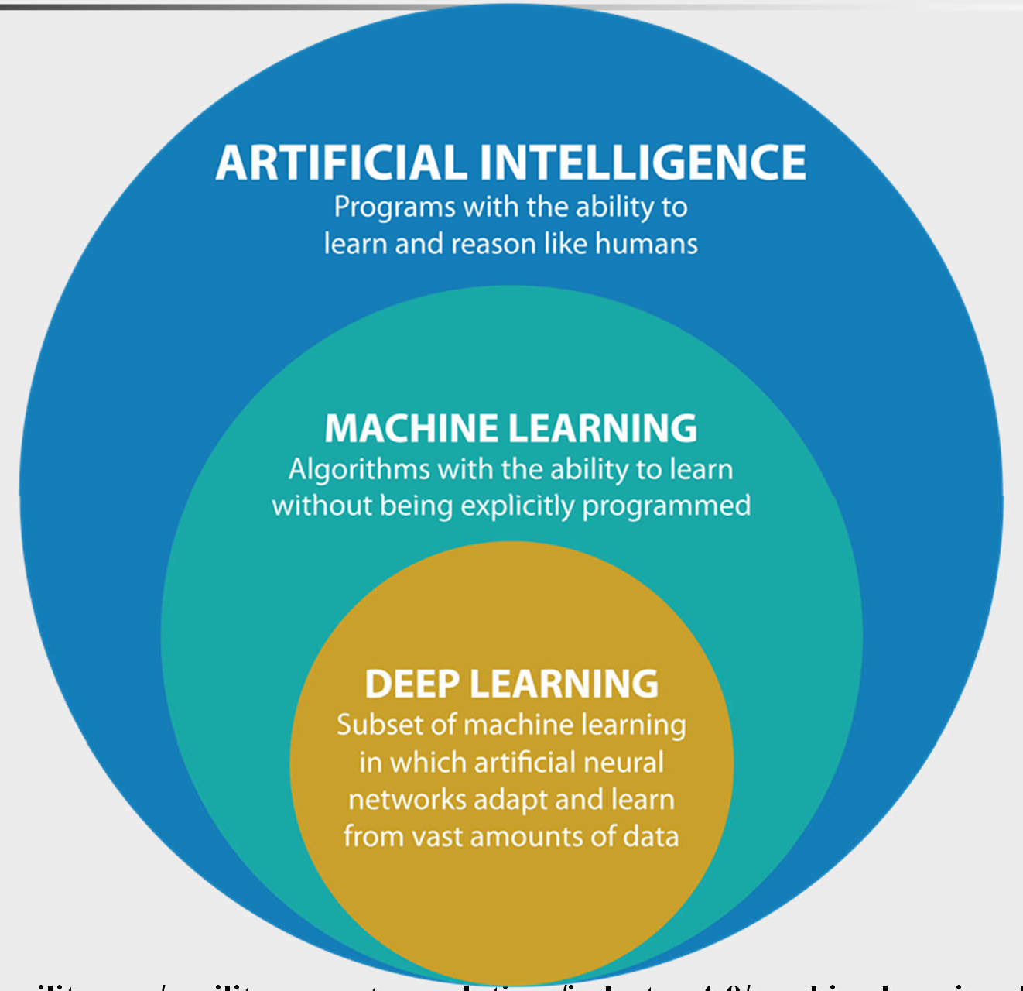
AI ->Machine Learning->Deep Learning
7
https://www.argility.com/argility-ecosystem-solutions/industry-4-0/machine-learning-deep-learning/

Slide 5
AI ->Machine Learning->Deep Learning
8
Artificial Intelligence (AI)
AI is the broadest term, applying to any technique that enables computers to mimic human intelligence, using logic, if-then rules, decision trees, and machine learning (including deep learning).
Machine Learning
The subset of AI that includes that enable machines to improve at tasks with experience. The category includes deep learning.
Deep Learning
The subset of machine learning composed of algorithms to train itself to perform tasks, like speech and image recognition, by exposing multilayered neural networks to vast amounts of data.

Slide 6
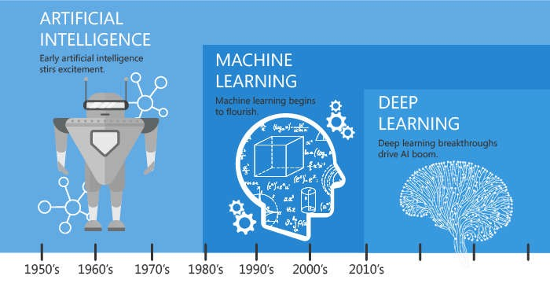
AI ->Machine Learning->Deep Learning
9

Slide 7
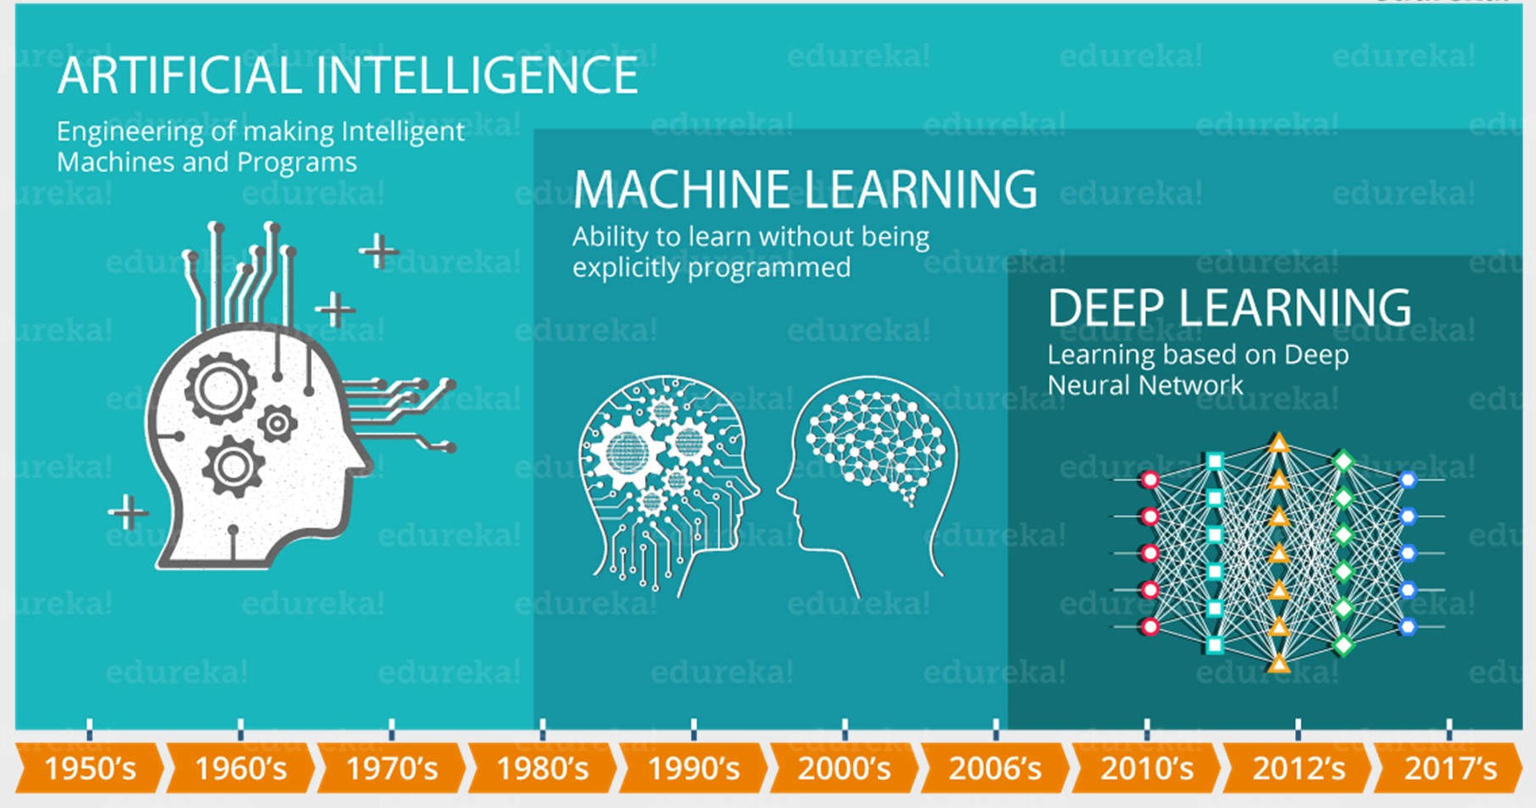
AI ->Machine Learning->Deep Learning
10

Slide 8
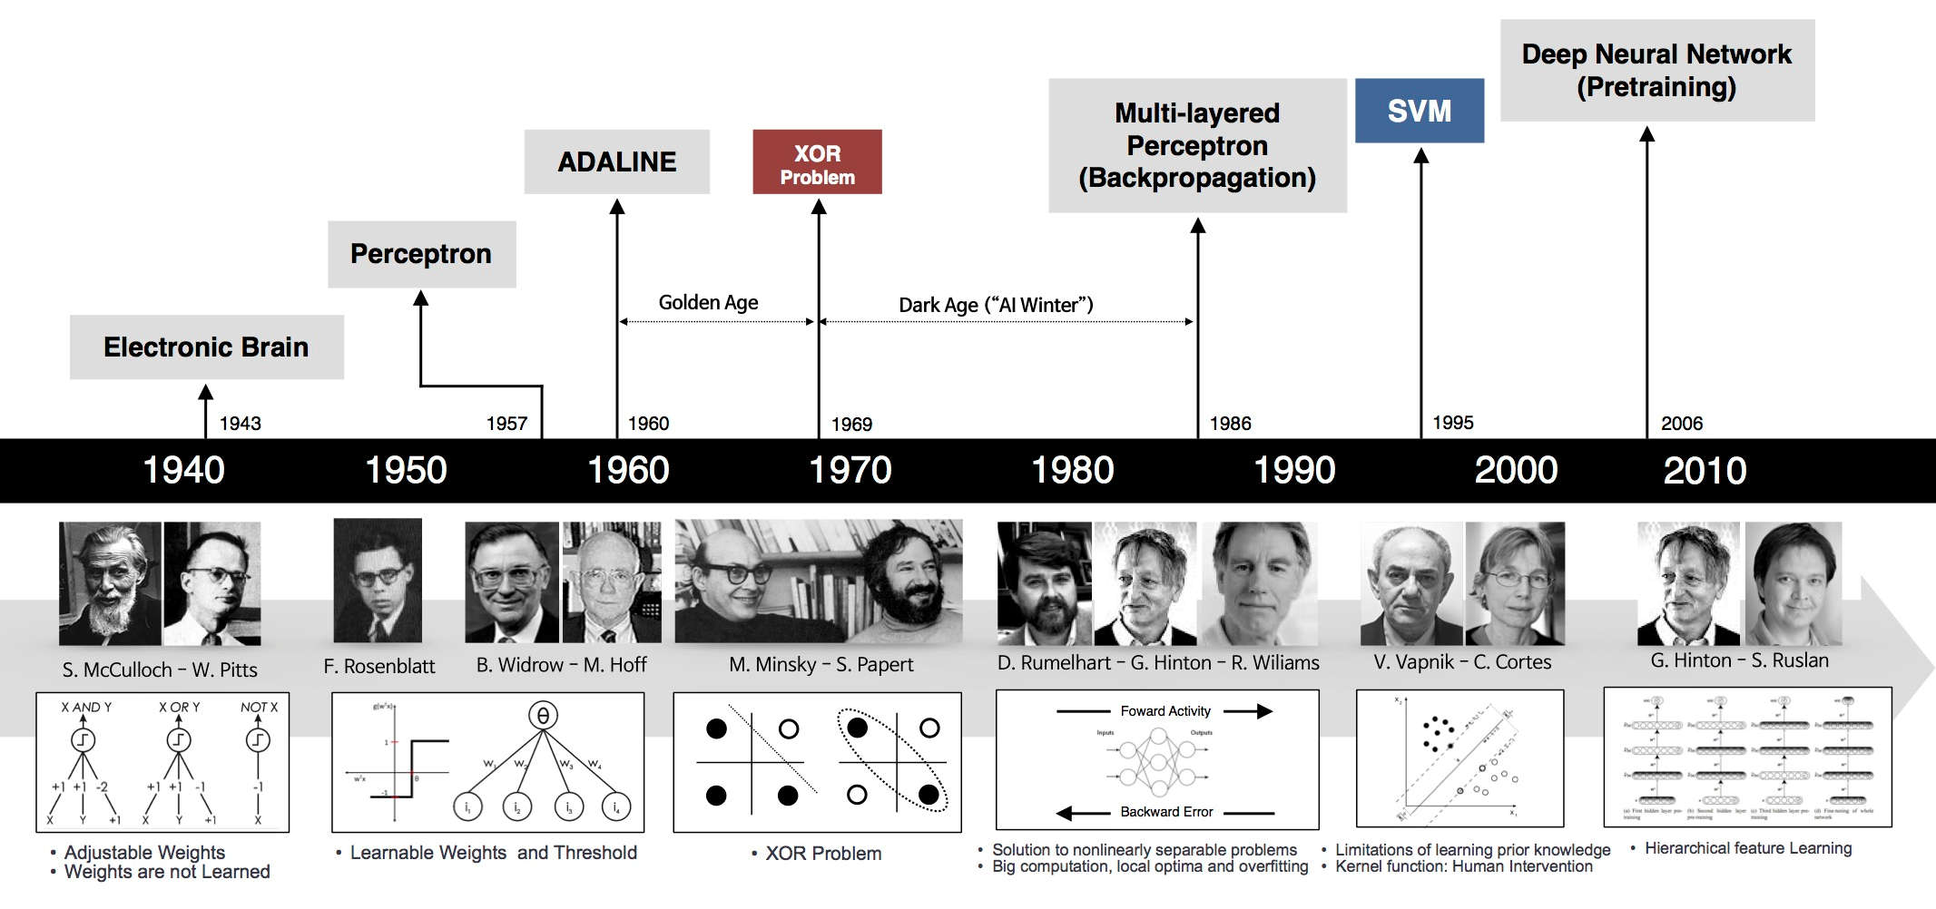
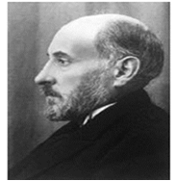
History and Background of Deep Learning
11
1906
Neuron/ Nerve Cell
Ramon y Cajal
Artificial Neuron
Solving Real-Life Problem with Extracted Features
Development of Traditional Machine Learning
Deep Leaning
https://beamandrew.github.io/deeplearning/2017/02/23/deep_learning_101_part1.html

Slide 9
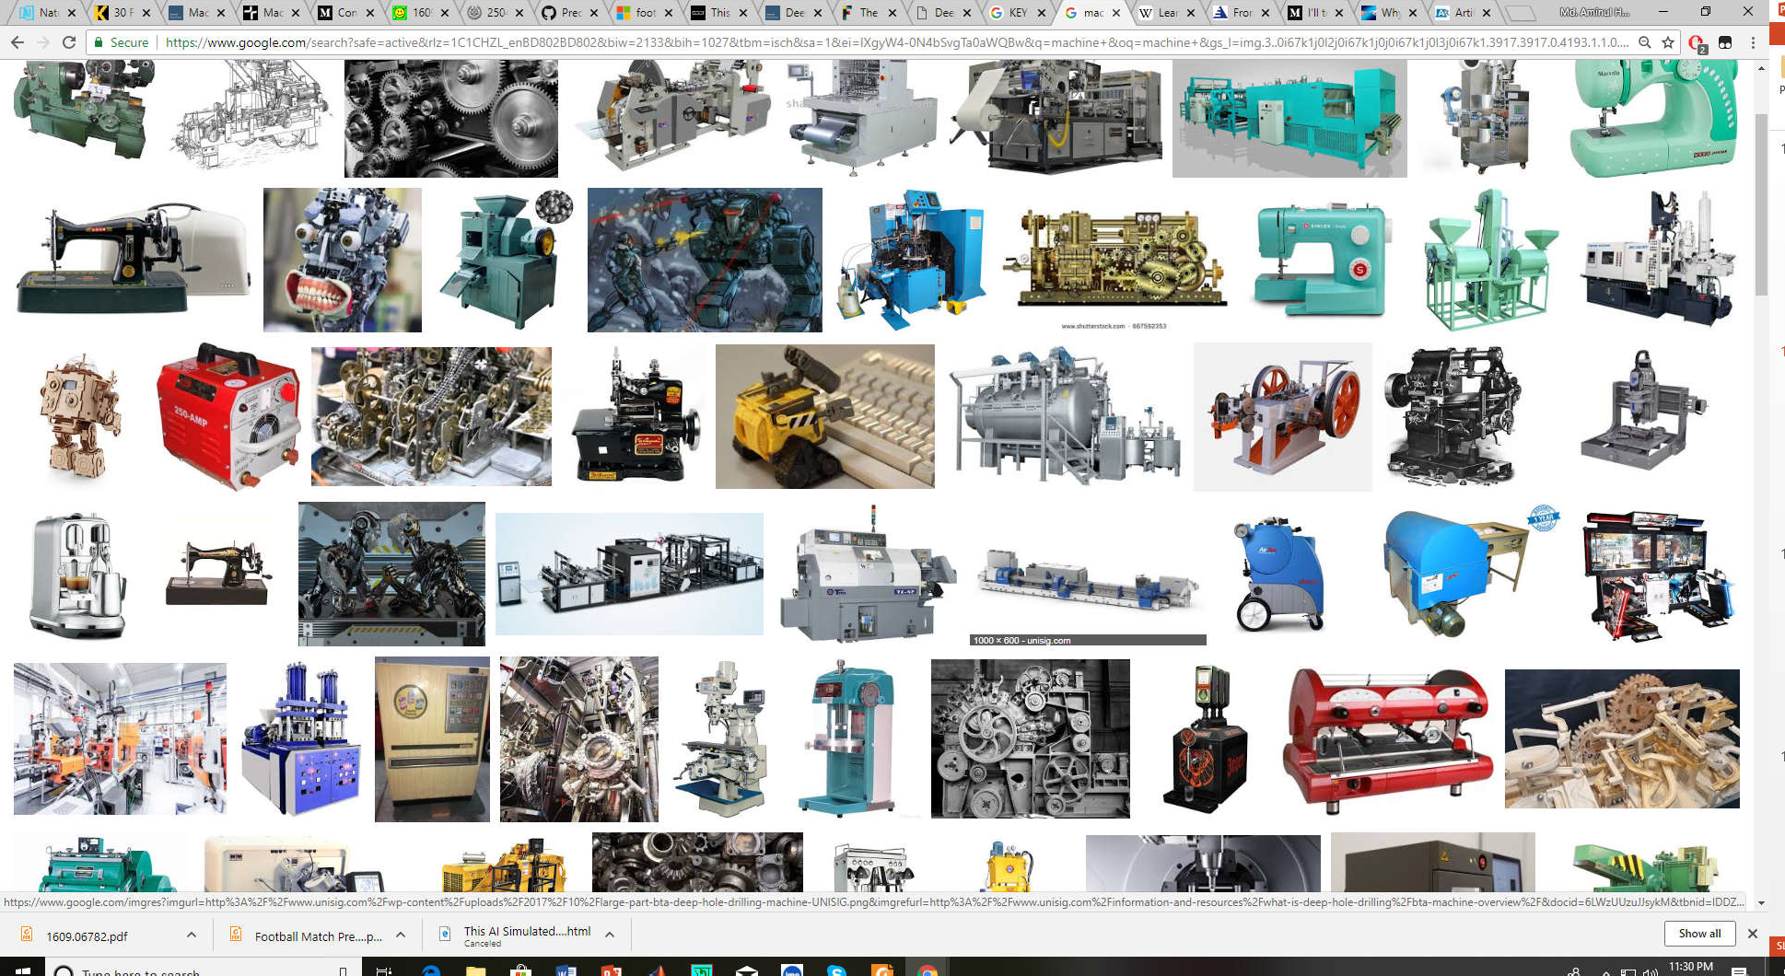
Machine
12
A machine uses power to apply forces and control movement to perform an intended action. Machines include a system of mechanisms that shape the actuator input to achieve a specific application of output forces and movement.

Slide 10
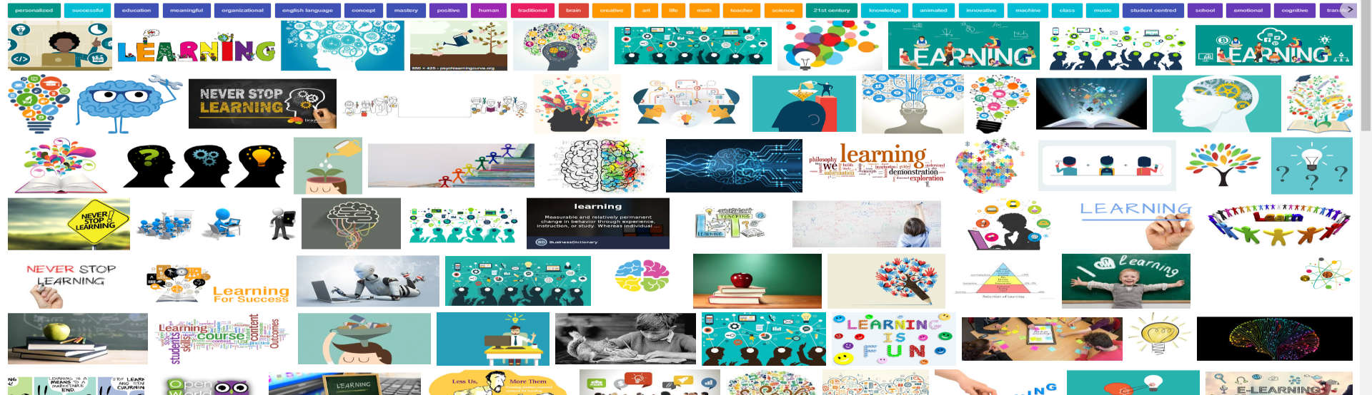
Learning (Human)
13
Learning is the process of acquiring new or modifying
existing knowledge, behaviors, skills, values, or preferences
Another Definition
“A change in human disposition or capability that persists over a period of time and is not simply ascribable to processes of growth.”
Human brain is the main element of learning

Slide 11
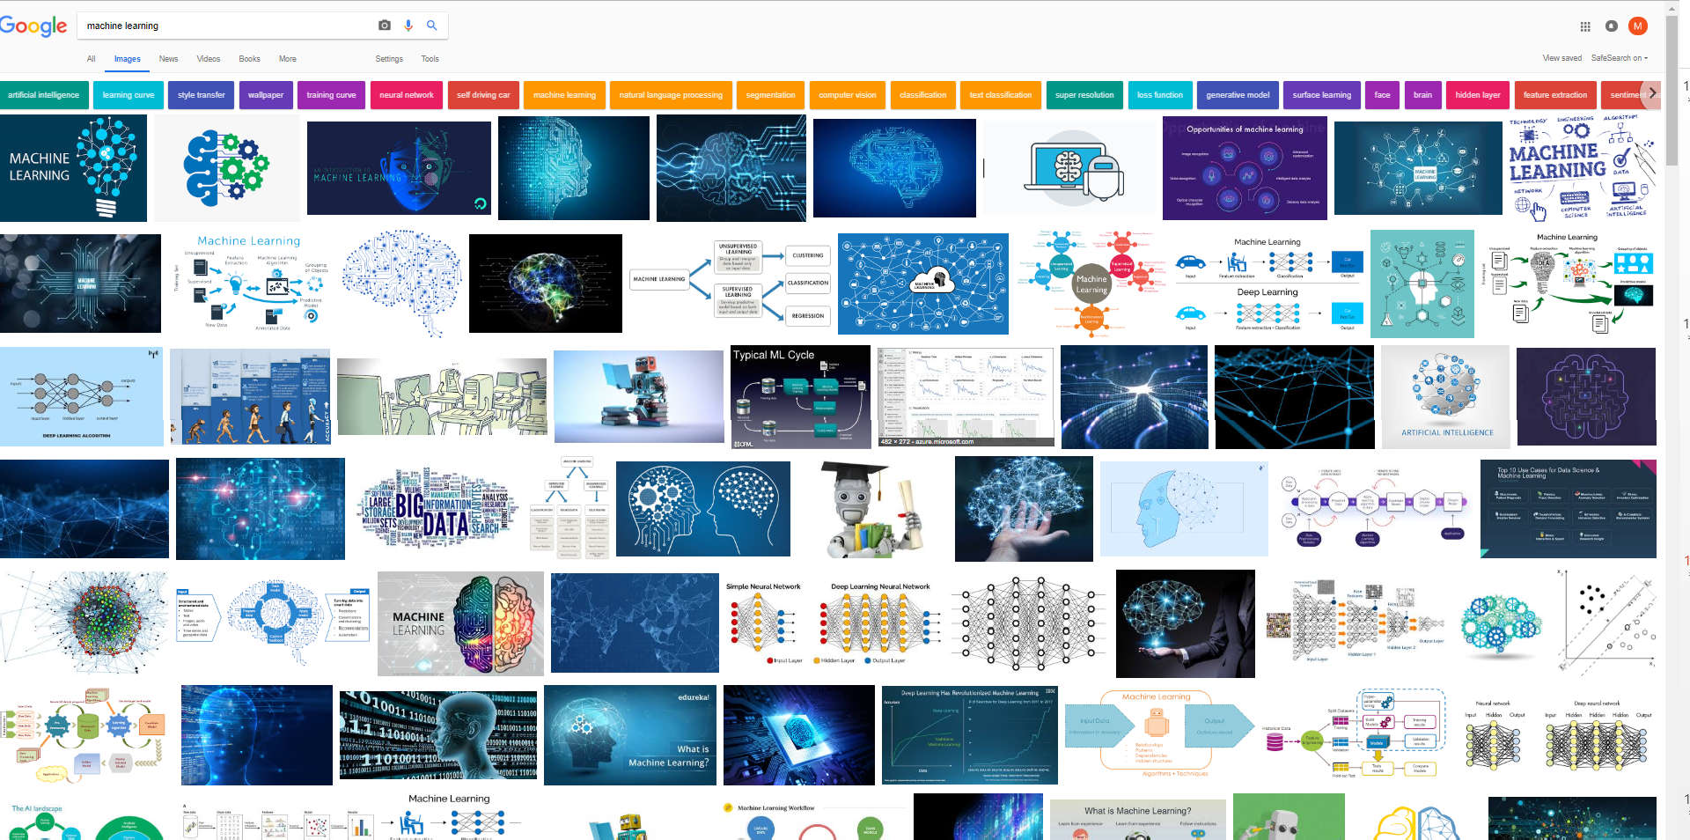
Machine Learning
14
Technique to give computer brain like learning ability through progressively update with data, without being explicitly programmed.

Slide 12
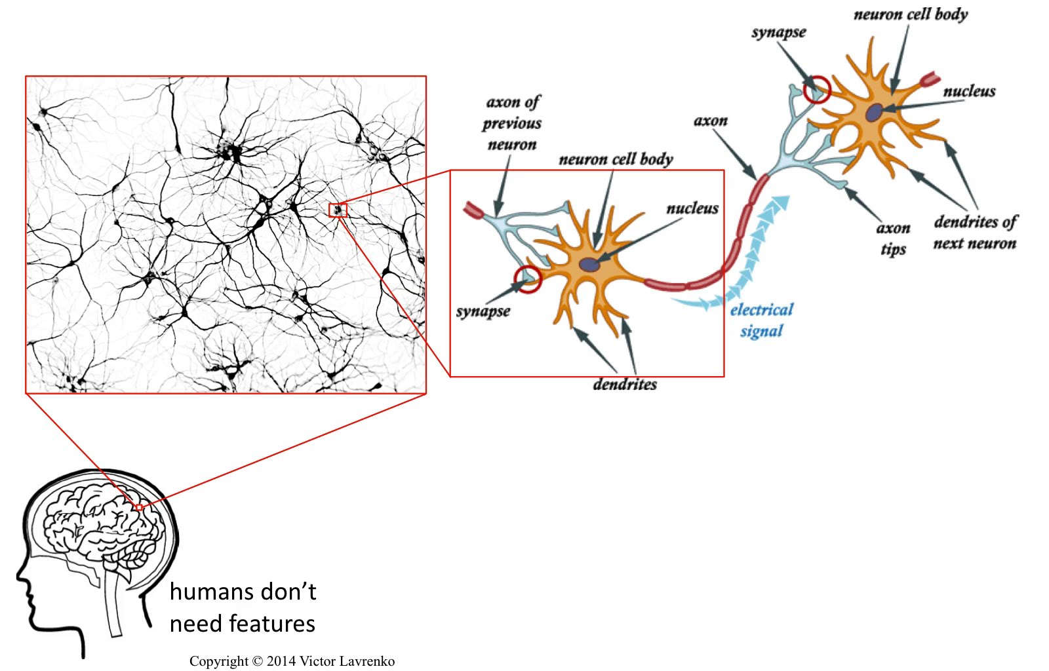
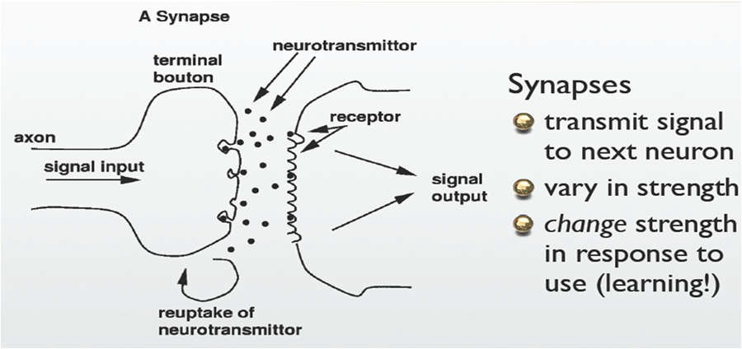
Neuron : Learning Element in Brain
(Discovered in 1906)
15

Slide 13
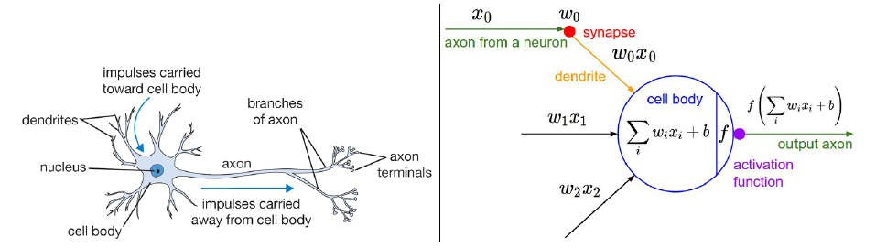
16
McCulloch-Pitts model of a Neuron
(Proposed in 1943)

Slide 14
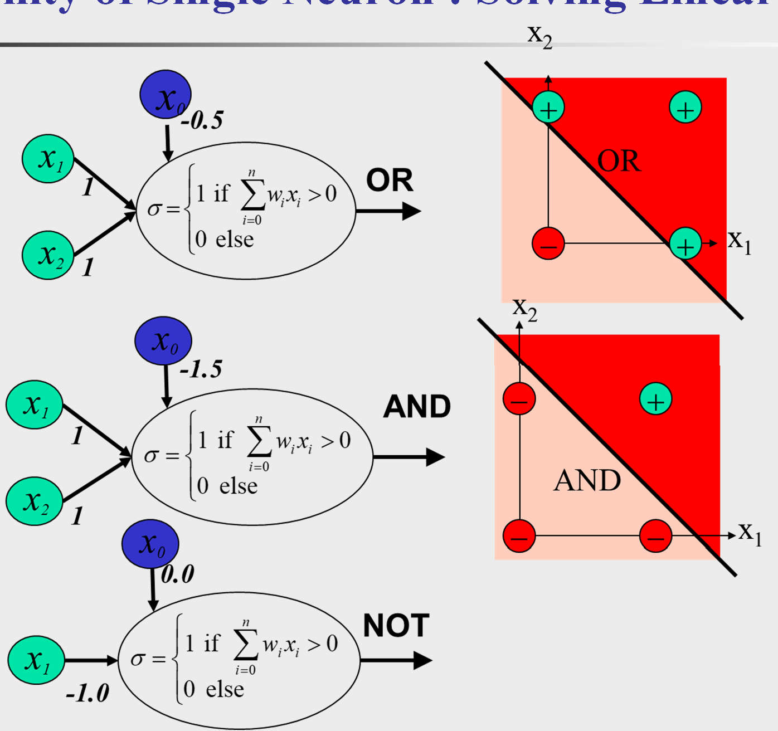
Ability of Single Neuron : Solving Linear Problem

Slide 15
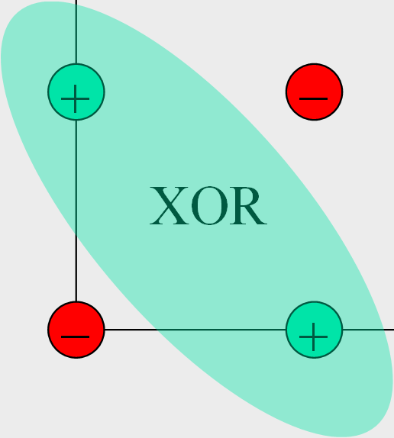
Ability of Single Neuron: Unable to Solve Nonlinear Problem
x₂
x₀
?
+ −
XOR
− +
x₁
?
⎧
n
∑
XOR
_{ο =} ⎪1 if
w_{i} x_{i} > 0
⎨
i=0
x
⎪⎩0 else
2
?
x₁
No arrangement work, not linearly separable. Require two boundary lines.

Slide 16
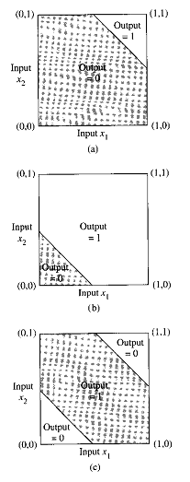
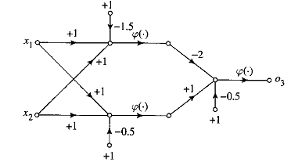
XOR solution with Hidden Neuron
19
AND
OR
XOR logic through manipulation by hidden neurons
XOR
Open doors to Solve Real life Nonlinear Problem

Slide 17






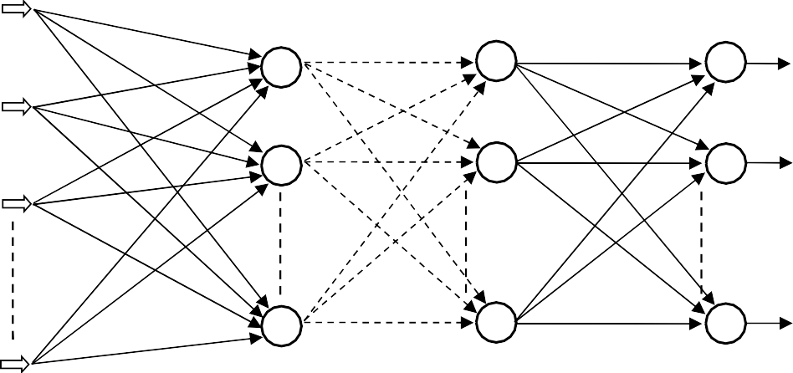
Neural Network: Hidden Layer Enhances Ability
20
Hidden Layer(s) Enhances Ability to Solve Real Life Nonlinear Problems
(Input Layer)
(Hidden Layer)
(Output Layer)
How to Select Appropriate Weight ? Learning?
(Input Layer)
(Hidden Layer)
(Hidden Layer)
(Output Layer)

Slide 18
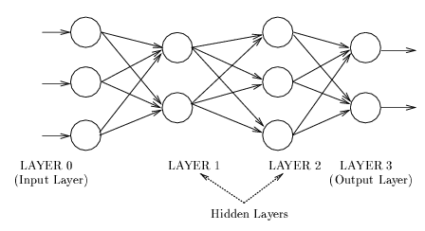
How to get appropriate weight set?
Back-propagation is the famous algorithm for training feed-forward networks
(Proposed in 1986)
http://en.wikipedia.org/wiki/Backpropagation
Backpropagation, or propagation of error, is a common method of teaching artificial neural networks how to perform a given task.
It was first described by Paul Werbos in 1974, but it wasn't until 1986, through the work of David E. Rumelhart, Geoffrey E. Hinton and Ronald J. Williams, that it gained recognition, and it led to a “renaissance” in the field of artificial neural network research.

Slide 19
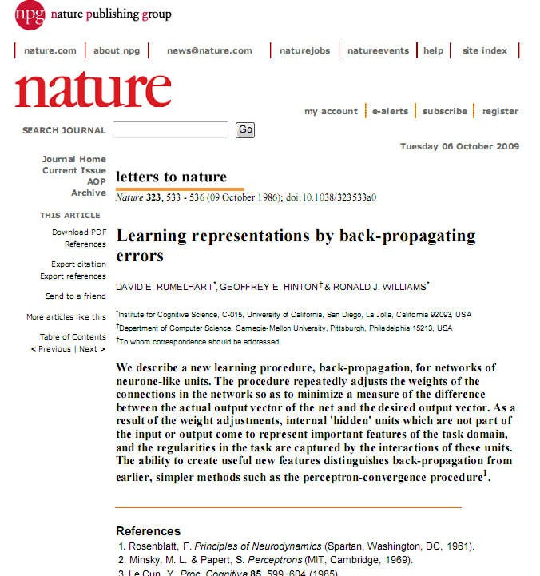
22

Slide 20
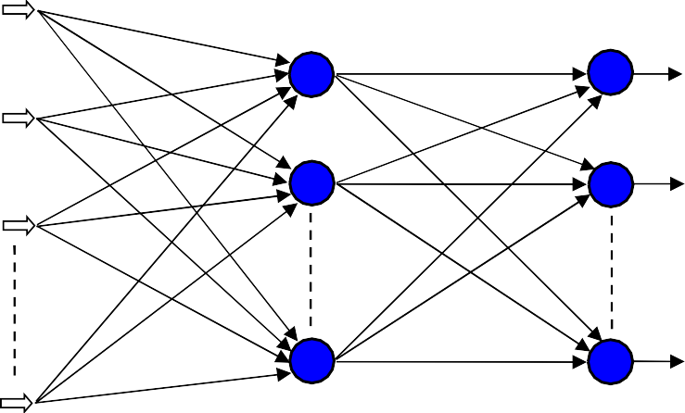
Back-propagation(BP)
Error = Desired Output
- Actual Output
Input
Output
(Input Layer) (Hidden Layer) (Output Layer)
Forward Pass: Error is calculated based on desired and actual output.
Backward Pass: Synaptic weights are adjusted based on calculated error.

Slide 21
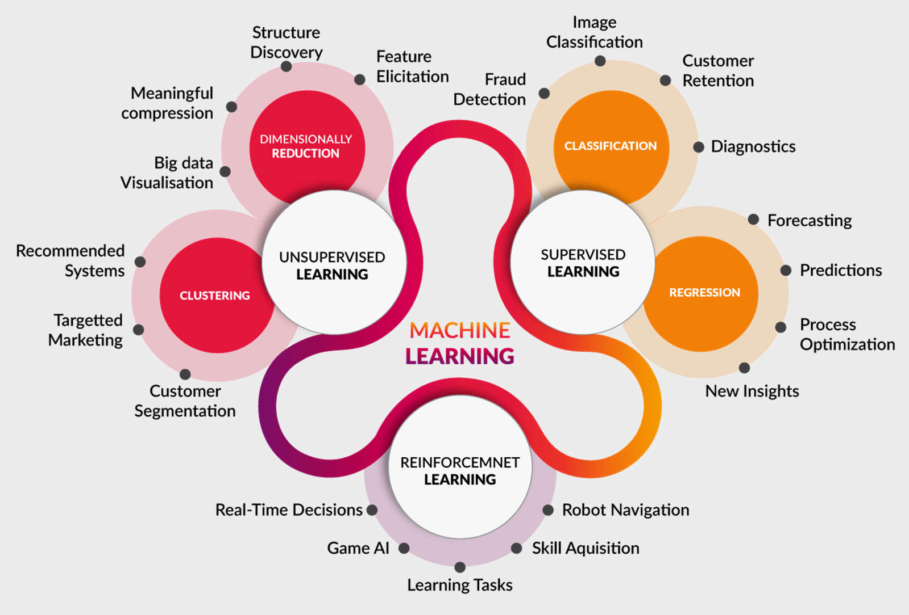
Applications of Machine Learning
24

Slide 22

25

Slide 23
Benchmark Problems
26
Problems Related to Human Life
Input Features of Diabetes
Problem | Task
Breast Cancer Wisconsin | Predicts whether a tumor is benign (not dangerous to health) or malignant (dangerous) based on a sample tissue taken from a patient’s breast.
BUPA Liver Disorder | Identify lever disorders based on blood tests along with other related information such as alcohol consumption.
Diabetes | Investigate whether the patient shows or not the signs of diabetes.
Heart Disease Cleveland | Predicting whether at least one of four major heart vessels is reduced in diameter by more than 50%.
Hepatitis | Anticipate status (i.e., live or die) of hepatitis patient.
Lymphography | Predict the situation of lymph nodes and lymphatic vessels.
Lungcancer | Identify types of pathological lung cancers.
Postoperative | Determine place to send patients for postoperative recovery.
Number of times pregnant
Plasma glucose concentration
Diastolic blood pressure
Triceps skin fold thickness (mm)
2-Hour serum insulin (mu U/ml)
Body mass index
Diabetes pedigree function
Age

Slide 24
Benchmark Problems
27
Problems Related to Finance
Problem | Task
Australian Credit Card | Classify people as good or bad credit risks depend on applicants’ particulars.
Car | Evaluate cars based on price and facilities.
Labor Negotiations | Identify a worker as good or bad i.e., contract with him beneficial or not.
German Credit Card | Like Australian Card, this problem also concerns to predict the approval or non-approval of a credit card to a customer.
Problems Related to Plants
Problem | Task
Iris Plants | Classify iris plant types.
Mushroom | Identify whether a mushroom is edible or not based on a description of the mushroom’s shape, color, odor, and habitat.
Soybean | Recognize 19 different diseases of soybeans.

Slide 25
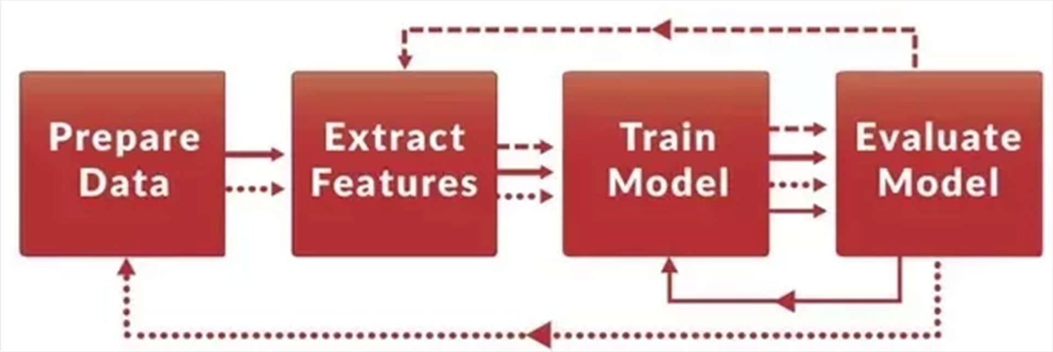
Machine Learning Process
28
Performance depends on feature extraction which requires heuristics and, most notably, a great deal of time

Slide 26
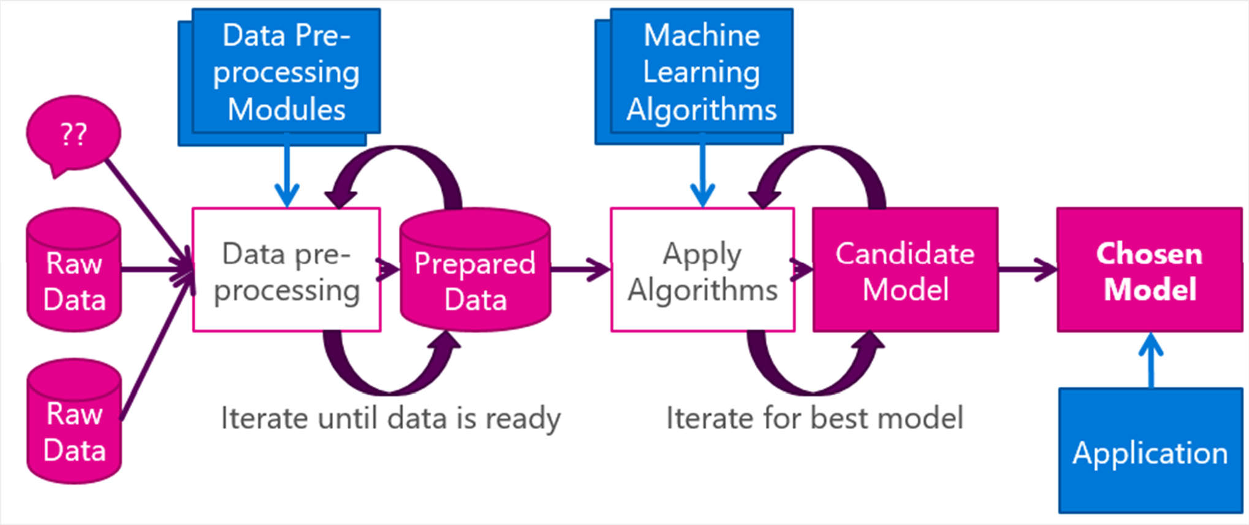
Machine Learning Process (Different View)
29
Performance depends on data pre-processing (i.e., feature extraction) which requires human expertize

Slide 27
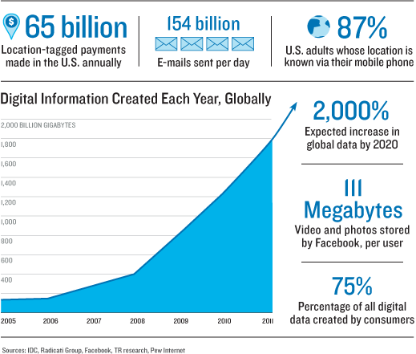
Why Deep Architecture?
30
For huge heterogeneous data feature extraction is challenging and training time unacceptable

Slide 28
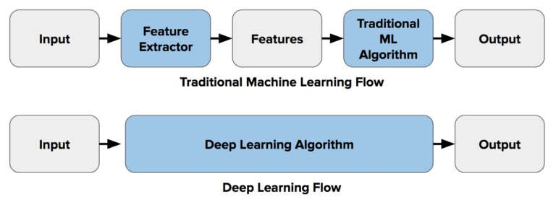
Motivation of Deep Learning
31

Slide 29
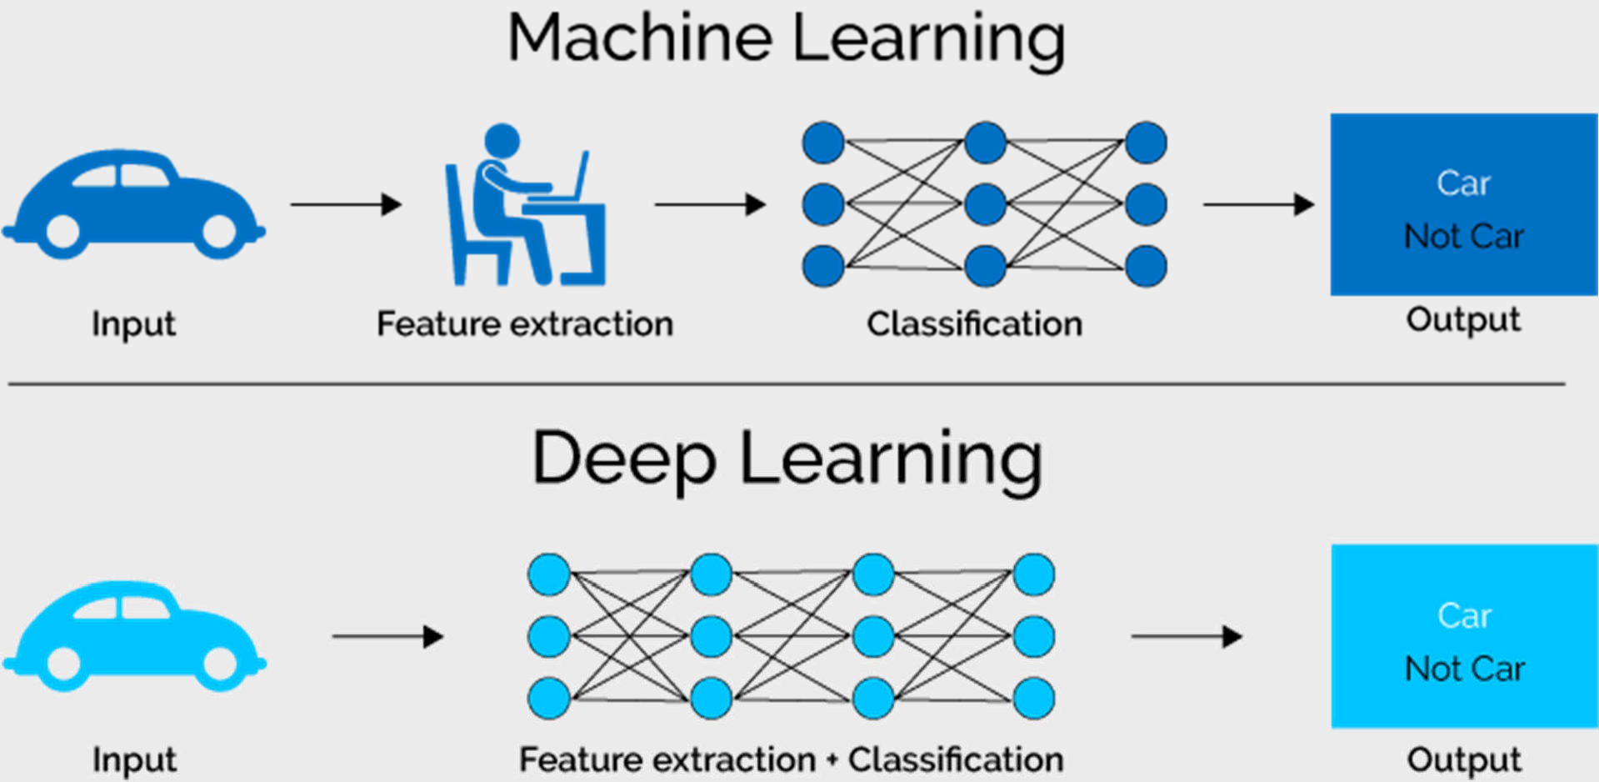
Machine Learning vs Deep Learning
32

Slide 30
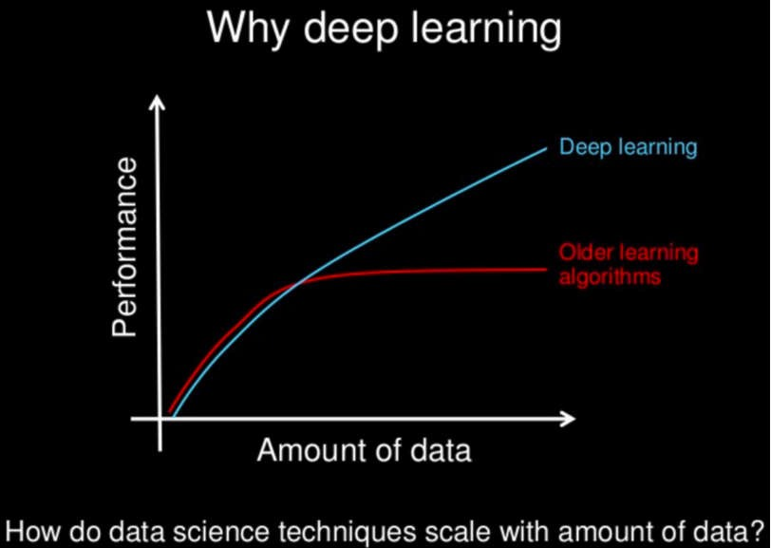
Machine Learning vs Deep Learning
33

Slide 31
Understanding Deep Learning
what exactly is deep learning ? And,
why is it generally better than other methods on image, speech and certain other types of data?
The short answers
‘Deep Learning’ means using a neural network
with several layers of nodes between input and output
the series of layers between input & output do feature identification and processing in a series of stages, just as our brains seem to.

Slide 32
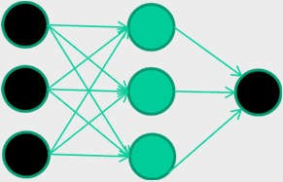
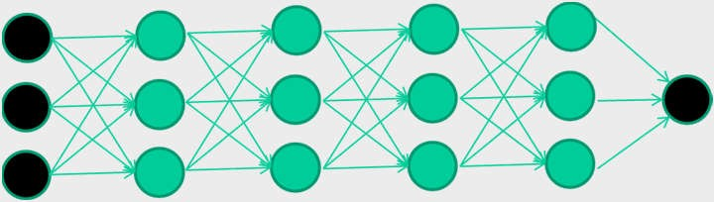
Understanding Deep Learning
3. multilayer neural networks have been around for 25 years. What’s actually new?
we have always had good algorithms for learning the weights in networks with 1 hidden layer
but these algorithms are not good at learning the weights for networks with more hidden layers
what’s new is: algorithms for training many-layer networks

Slide 33
When to use Deep Learning (DL)?
36
DL outperforms other techniques if the data size is large.
When there is lack of domain understanding for feature introspection, DL techniques outshines others as you have to worry less about feature engineering.
DL really shines when it comes to complex problems such as image classification, natural language processing, and speech recognition.

Slide 34
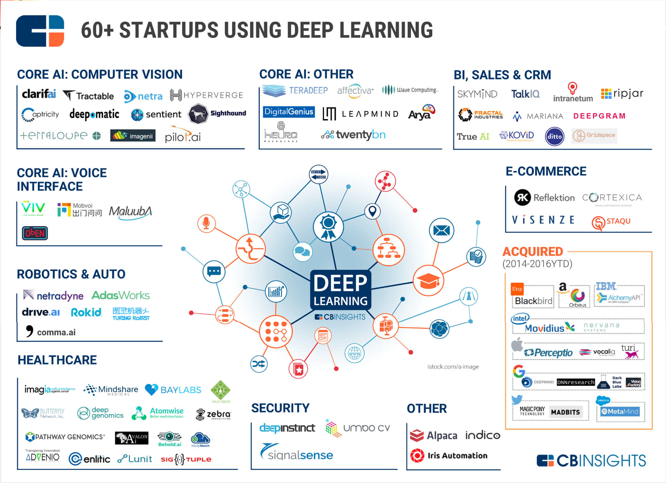
37

Slide 35

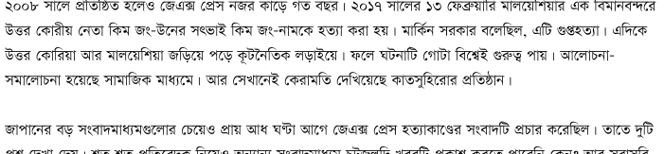
38
6/21/2018 About JX PRESS - English - JX通信社 https://jxpress.net/about/about-jx-press/ 2/5
The major technological areas where our company excels in the development of this kind of service are machine learning, deep learning, and natural language processing technology. Using these technologies, we aim to achieve qualitative improvements in journalism while simultaneously reducing
costs through this “mechanization of the news

Slide 36
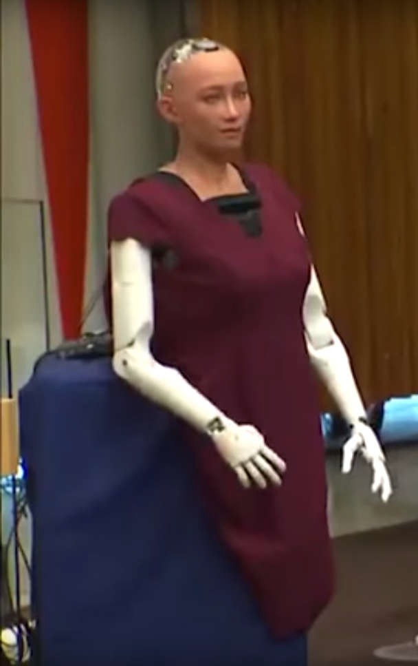
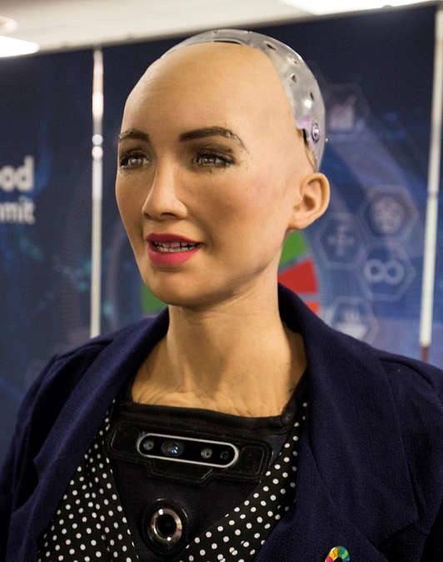
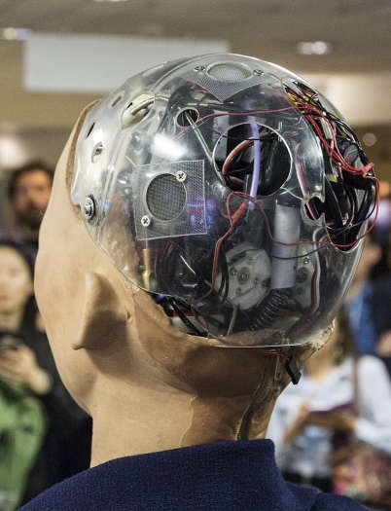
3
9
Sophia uses voice recognition (speech-to-text) technology from Alphabet Inc of Google.
--- Sophia does utilize AI methods including face tracking, emotion recognition, and robotic movements generated by deep neural networks. Sophia’s dialogue is generated via a decision tree, but is integrated with these outputs uniquely.

Slide 37
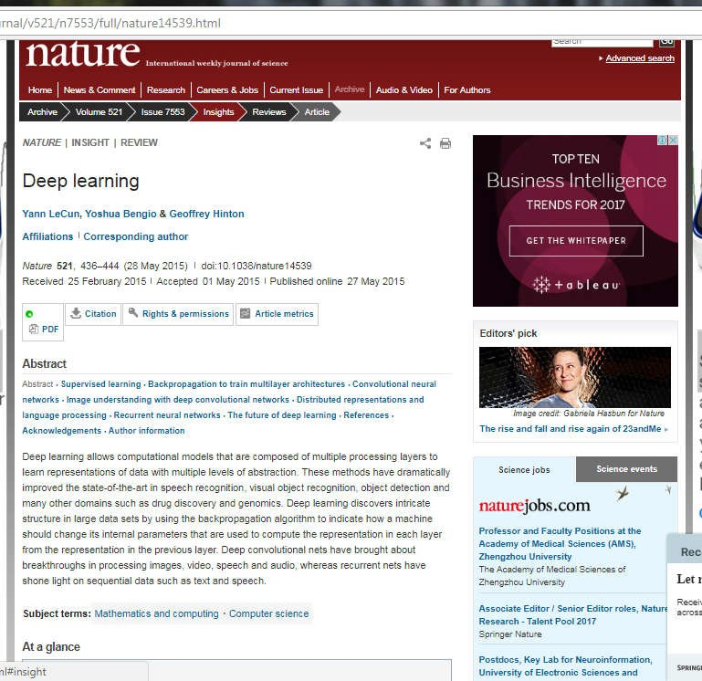

40
Deep Learning Review in Nature

Slide 38
Prominent Deep Learning Methods
41
Stacked Denoising Autoencoder (SDAE)
Deep Belief Network (DBN)
Final Architecture same as NN but preparation differs
Convolutional Neural Network (CNN)
Efficient for 2D data e.g., Image
Long Short-Term Memory (LSTM)
Developed for Sequential Data

Slide 39

41
No stopping of Deep Learning

